Slide 1
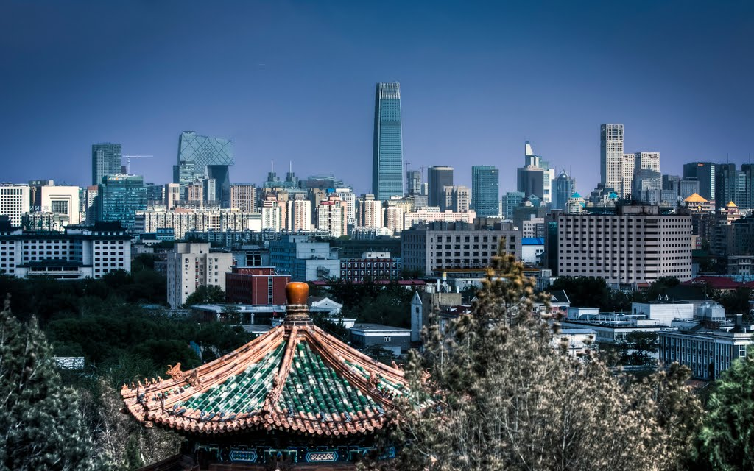


URBAN TOURISM AND DESTINATION MANAGEMENT
31 August 2017, Beijing, China
Esencan TERZIBASOGLU
Director
Destination Management and Quality
UN WORLD TOURISM ORGANIZATION
eterzibasoglu@unwto.org

Slide 2
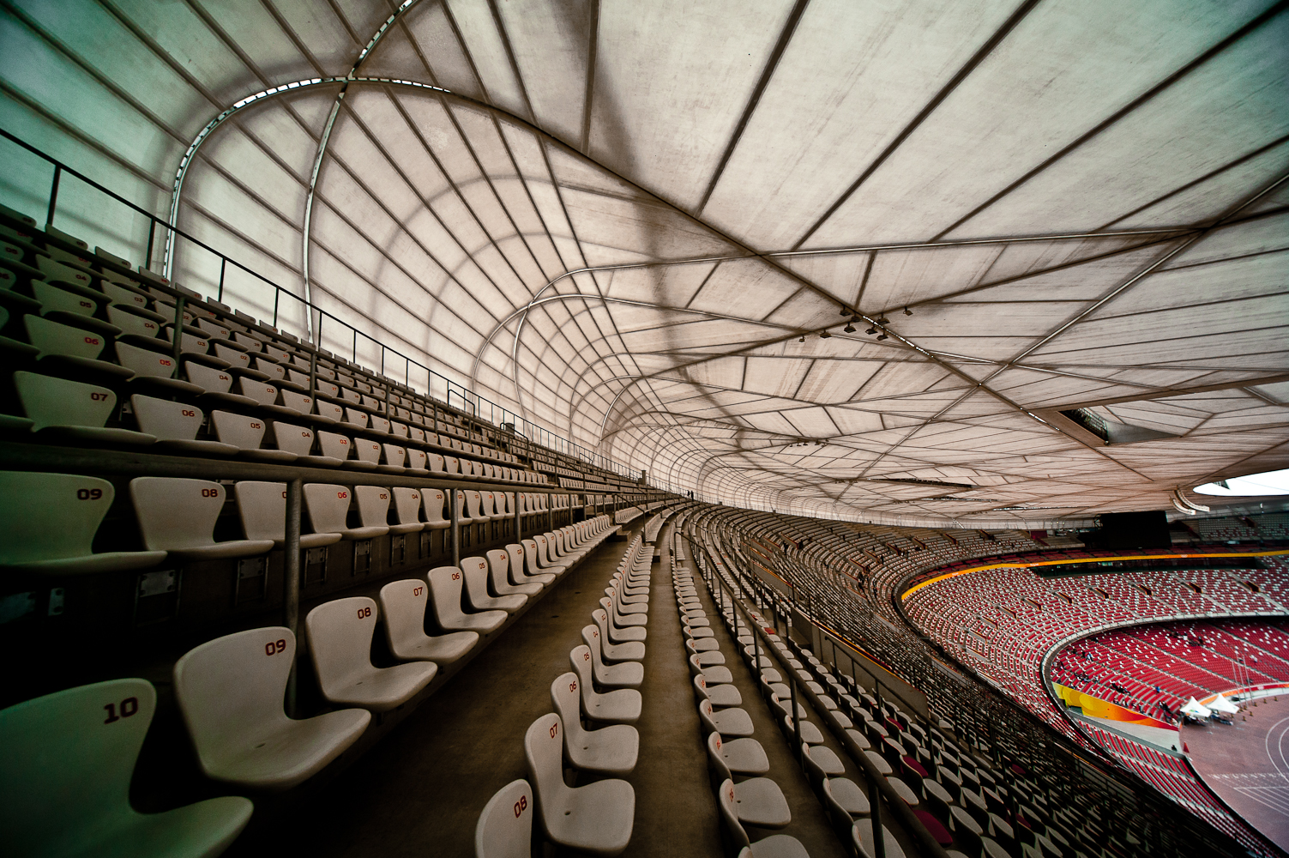
URBAN TOURISM AND DESTINATION MANAGEMENT
Structure:
Brief on “World tourism”
Introduction to Destination Management and Marketing, concepts and roles (UNWTO Definitions)
Principles and Process:
  Destination Management / Value Chain
  DMO Options
  Strengths and weaknesses of tourism governance models

Slide 3
URBAN TOURISM AND DESTINATION MANAGEMENT
Structure:
Framework for a Destination Management Strategy
(A Strategic Planning Model)
Tourism Product Development Process
A Model for Destination Competitiveness
Destination Quality Management
New Paradigms in Urban Tourism
Observations and Recommendations, keys to success
Discussions

Slide 4
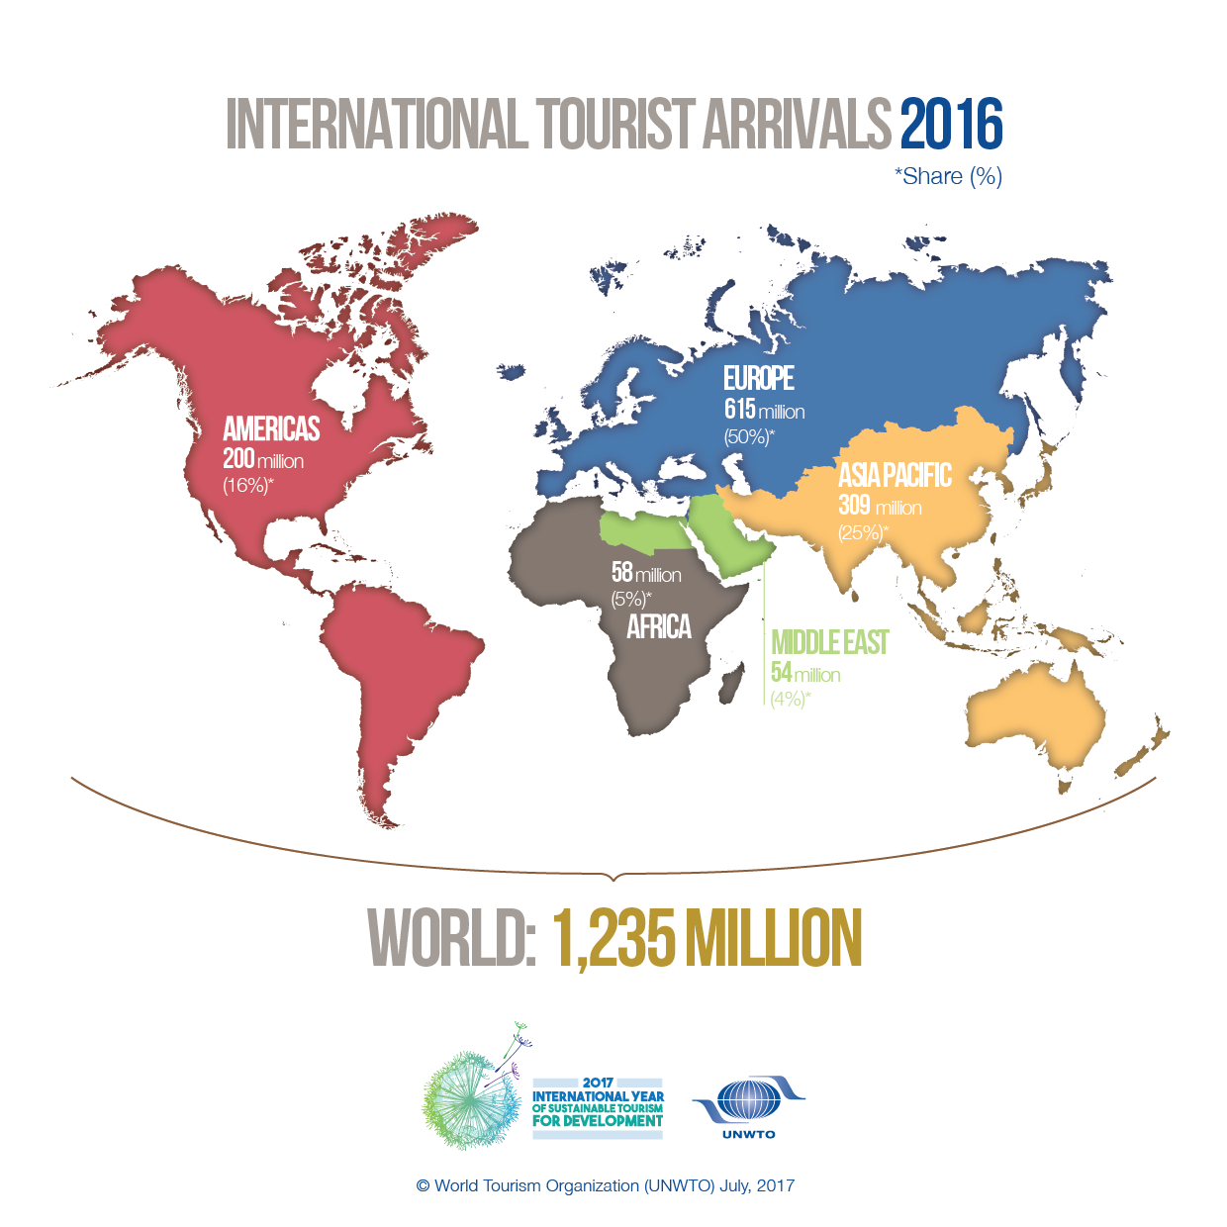
(UNWTO)

Slide 5
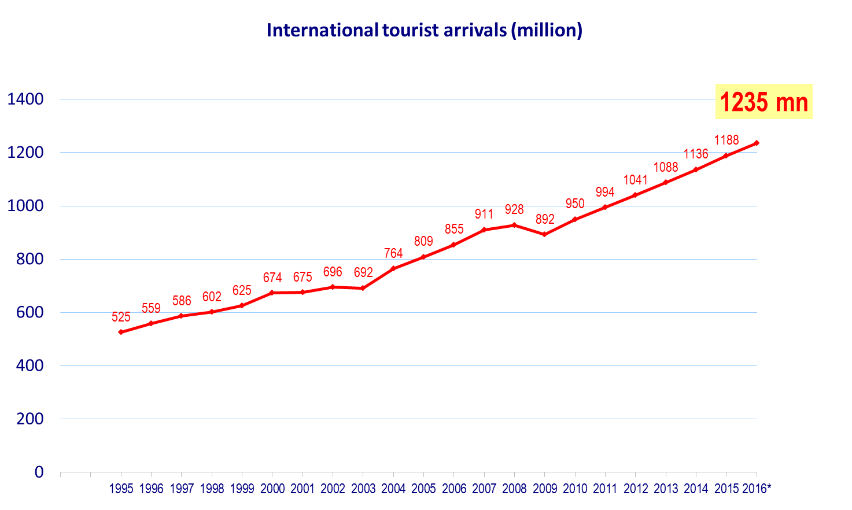
INBOUND TOURISM IN THE WORLD
46 million arrivals more than in 2015
306 million arrivals more than in pre-crisis year 2008
Source: World Tourism Organization (UNWTO)

Slide 6
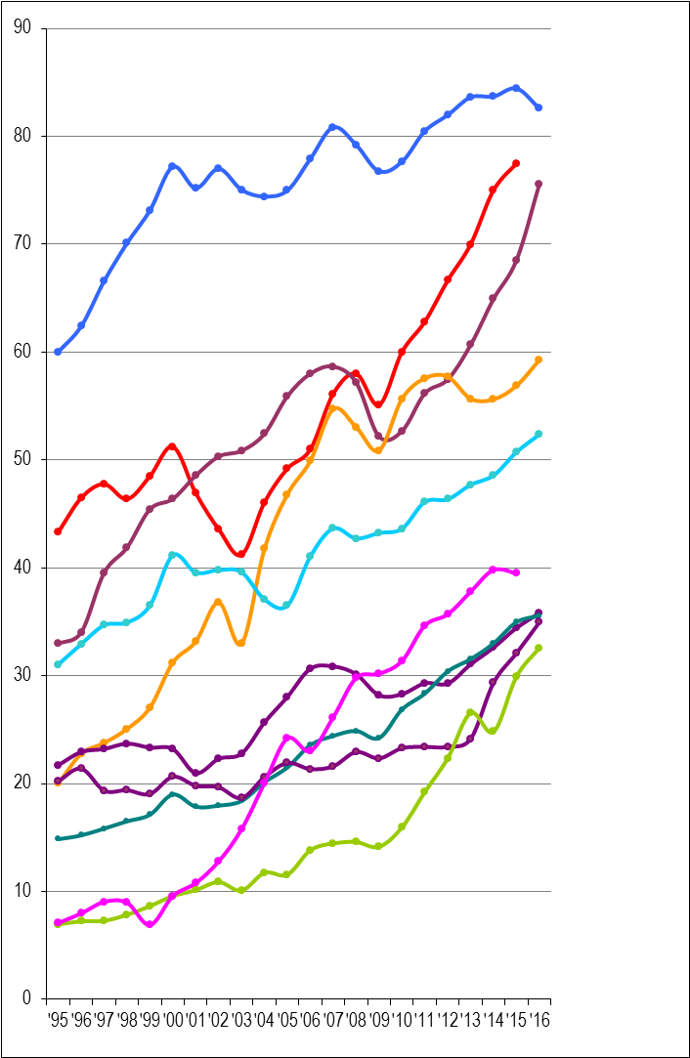
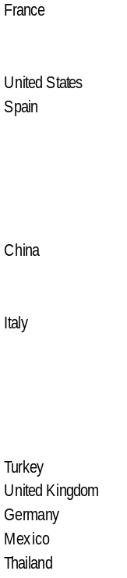
TOP WORLD DESTINATIONS (2016)
By Int. Tourist Arrivals
(million)
1. France 83
2. USA 77 (2015)
3. Spain 76
4. China 59
5. Italy 52
6. UK 36
7. Germany 36
8. Mexico 35
9. Thailand 33
10. Turkey n/a

Slide 7
TOP WORLD DESTINATIONS (2016)
By Int. Tourist Arrivals
(million)
1. France 83
2. USA 77 (2015)
3. Spain 76
4. China 59
5. Italy 52
6. UK 36
7. Germany 36
8. Mexico 35
9. Thailand 33
10. Turkey n/a
Int. Tourism Receipts
(US$ billion)
1. USA 206
2. Spain 60
3. Thailand 50
4. China 44
5. France 42
6. Italy 40
7. UK 40
8. Germany 37
9. HK (China) 33
10. Australia 32

Slide 8
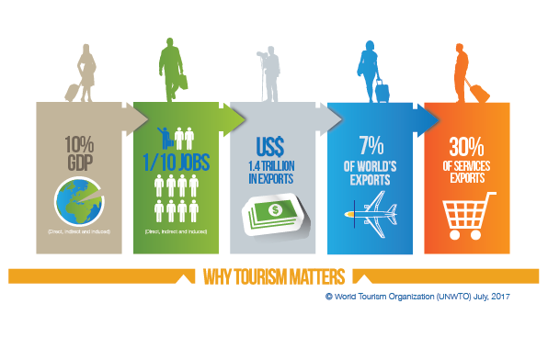

THE IMPORTANCE OF TOURISM

Slide 9
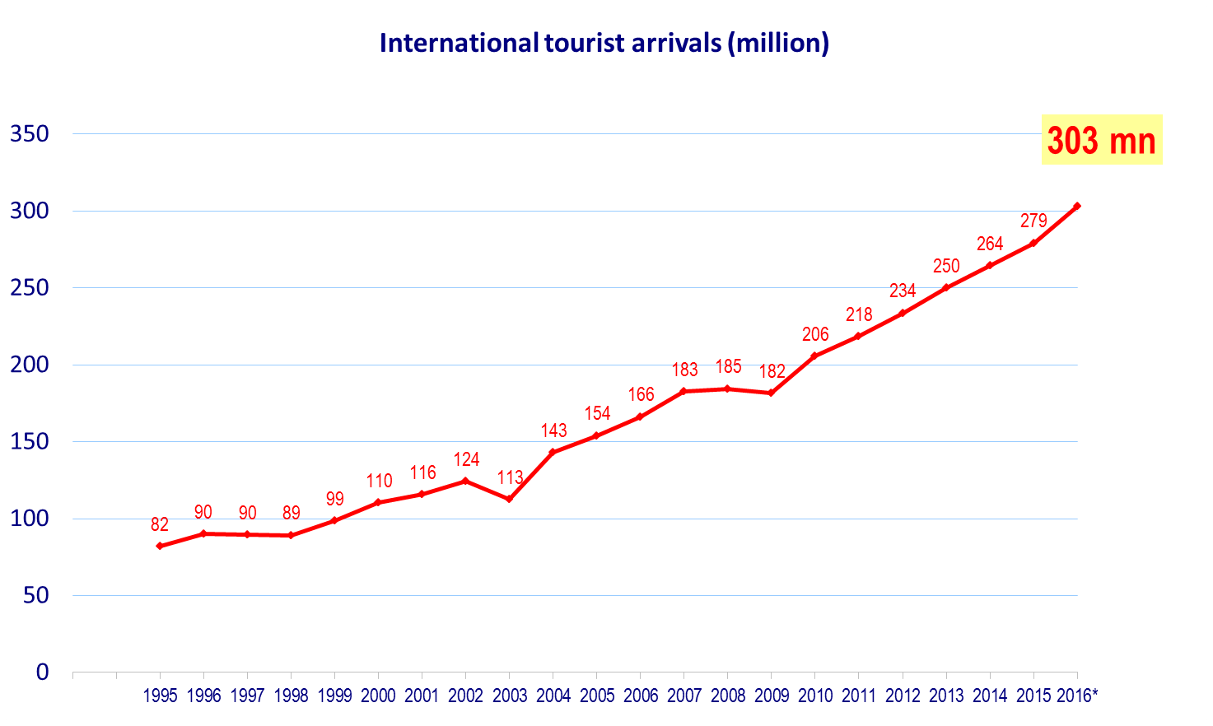
INBOUND TOURISM IN ASIA AND THE PACIFIC
24 million arrivals more than in 2015
118 million arrivals more than in pre-crisis year 2008
Source: World Tourism Organization (UNWTO)

Slide 10
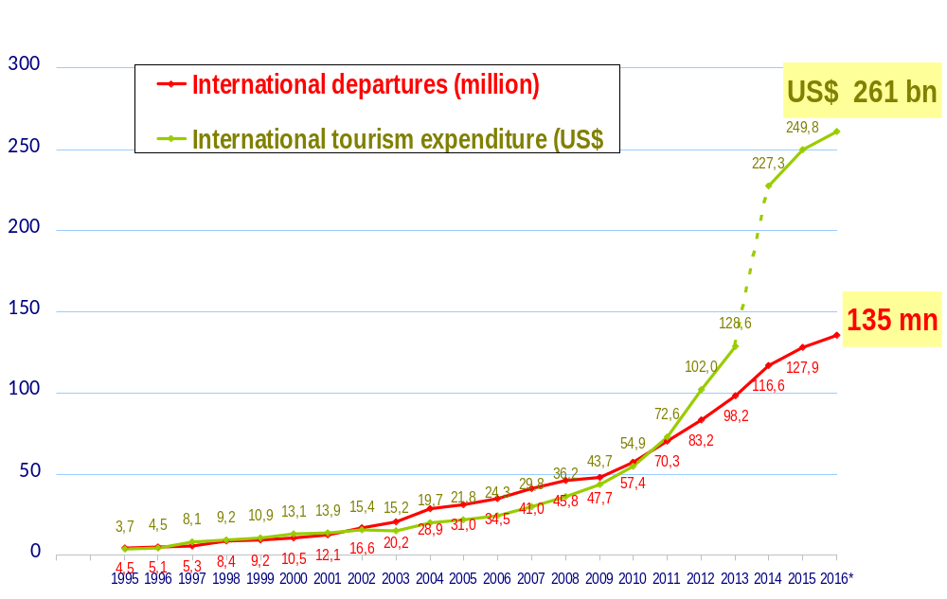
OUTBOUND TOURISM FROM CHINA
Source: World Tourism Organization (UNWTO)

Slide 11

INTRODUCTION TO DESTINATION MANAGEMENT AND MARKETING
Concepts & Definitions:
A TOURISM DESTINATION is a physical space with or without administrative and/or analytical boundaries in which a visitor can spend an overnight. It is the cluster (co-location) of products and services, and of activities and experiences along the tourism value chain and a basic unit of analysis of tourism. A destination incorporates various stakeholders and can network to form larger destinations. It is also intangible with its image and identity which may influence its market competitiveness.

Slide 12
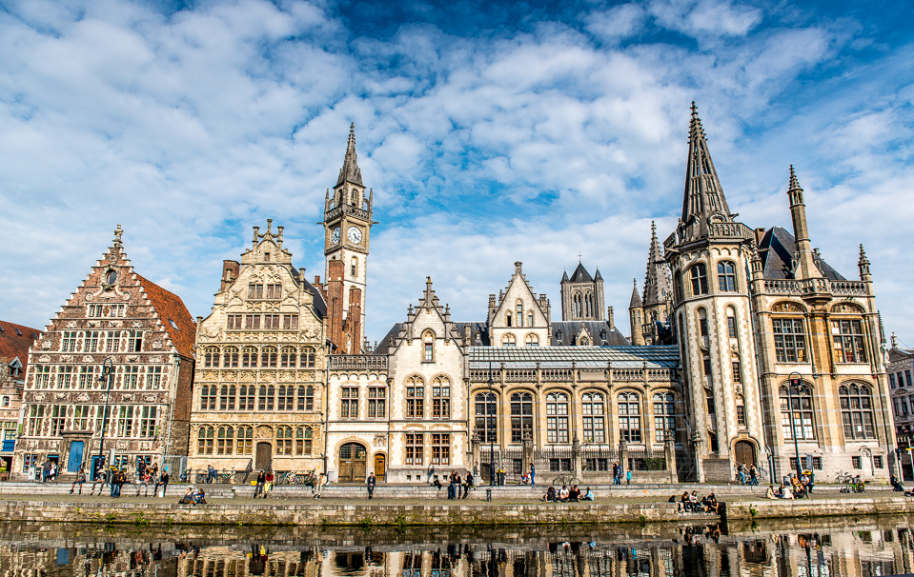
INTRODUCTION TO DESTINATION MANAGEMENT AND MARKETING
A DESTINATION MANAGEMENT/ MARKETING ORGANIZATION (DMO):is the leading organizational entity which may encompass the various authorities, stakeholders and professionals and facilitates tourism sector partnerships towards a collective destination vision. The governance structures of DMOs vary from a single public authority to a public/private partnership model with the key role of initiating, coordinating and managing certain activities such as implementation of tourism policies, strategic planning, product development, promotion and marketing and convention bureau activities.
The functions of the DMOs may vary from national to regional and local levels depending on the current and potential needs as well as on the decentralization level of public administration. Not every tourism destination has a DMO.

Slide 13

INTRODUCTION TO DESTINATION MANAGEMENT AND MARKETING
A TOURISM PRODUCT: is a combination of tangible and intangible elements, such as natural, cultural and man-made resources, attractions, facilities, services and activities around a specific center of interest which represents the core of the destination marketing mix and creates an overall visitor experience including emotional aspects for the potential customers. A tourism product is priced and sold through distribution channels and it has a life-cycle.

Slide 14

INTRODUCTION TO DESTINATION MANAGEMENT AND MARKETING
TOURISM VALUE CHAIN: is the sequence of primary and support activities which are strategically fundamental for the performance of the tourism sector. Linked processes such as policy making and integrated planning, product development and packaging, promotion and marketing, distribution and sales and destination operations and services are the key primary activities of the tourism value chain.
Support activities involve transport and infrastructure, human resource development, technology and systems development and other complementary goods and services which may not be related to core tourism businesses but have a high impact on the value of tourism.

Slide 15
DESTINATION MANAGEMENT &
TOURISM VALUE CHAIN
QUALITY
PERFORMANCE:
DESTINATION PLANNING:
ZONING, TRANSPORT, INFRASTRUCTURE ,
INVESTMENT , HUMAN RESOURCES ,
COMPLEMENTARY GOODS AND SERVICES
PROMOTION AND MARKETING
DISTRIBUTION AND SALES
DESTINATION OPERATION AND SERVICES
PRODUCT DEVELOPMENT AND PACKAGING
FEEDBACK AND FOLLOW UP:
INDUSTRY AND THE CUSTOMER

Slide 16
DESTINATION MANAGEMENT &
TOURISM VALUE CHAIN
MARKET
SITUATIONAL CONDITIONS
Core resources
and attractions:
(natural, cultural
man-made)
Price
Public &
private amenities
To attract visitors
To provide unique
visitor experience
Image, identity and
character
Accessibility
Human resources

Slide 17
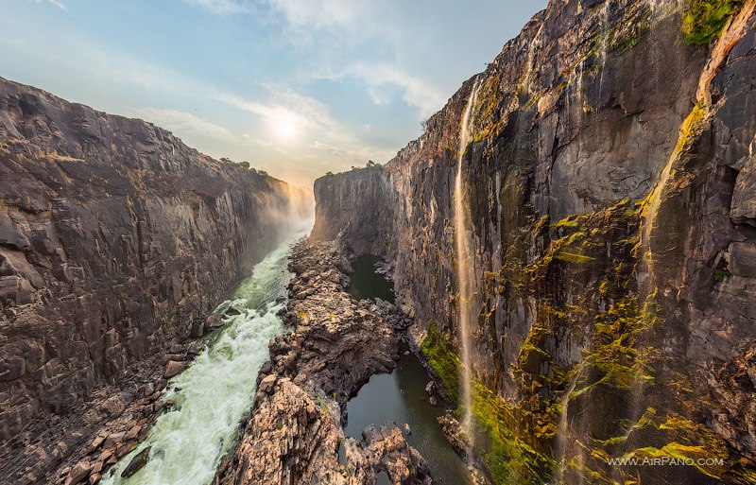
DESTINATION MANAGEMENT / MARKETING ORGANIZATIONS
OPTIONS FOR DM /GOVERNANCE:
Single public authority,
DMO STAKEHOLDERS:
National, regional and /or provincial government,
Partnership of public authorities, serviced by partners,
Public authority(ies) outsourcing delivery to private companies,
Public-private partnership in funding and operations,
Public-private partnership for certain functions, often in the form of a non-profit making company,
Association or company funded purely by a private sector partnership,
Economic development agencies,
Local authorities /municipality,
City Centre management organizations,
Institutions representing commercial activities ( e.g. chambers of commerce)
Convention bureaus,
National Park authorities,
Transport providers,
Attractions, events and cultural stakeholders,
Accommodation providers,
Restaurant, leisure and retail operators,
Intermediaries (tour operators, travel agencies),
Local tourism consortia and partnerships,
Skill development institutions, etc.

Slide 18
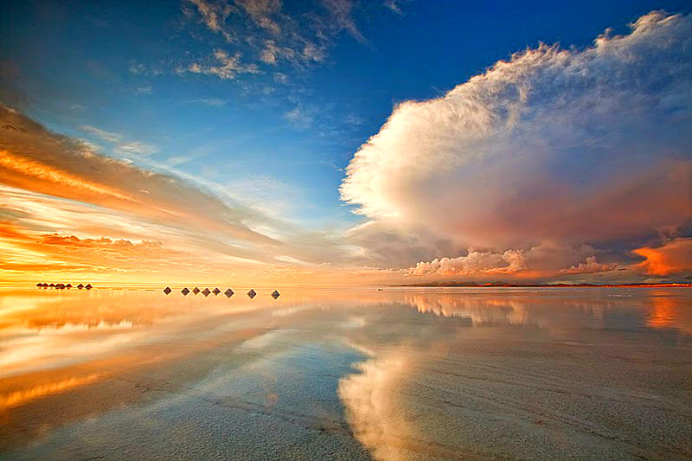
DESTINATION MANAGEMENT / MARKETING ORGANIZATIONS
PUBLIC SECTOR - STRENGTHS: | PRIVATE SECTOR -STRENGTHS:
Long – term strategic planning Destination awareness Public administration SME Support Quality assurance | Short-term tactic bussiness approach Marketing and sales approach Customers Relationship Management Market opportunity awareness Fast decision-making Local community involvement

Slide 19
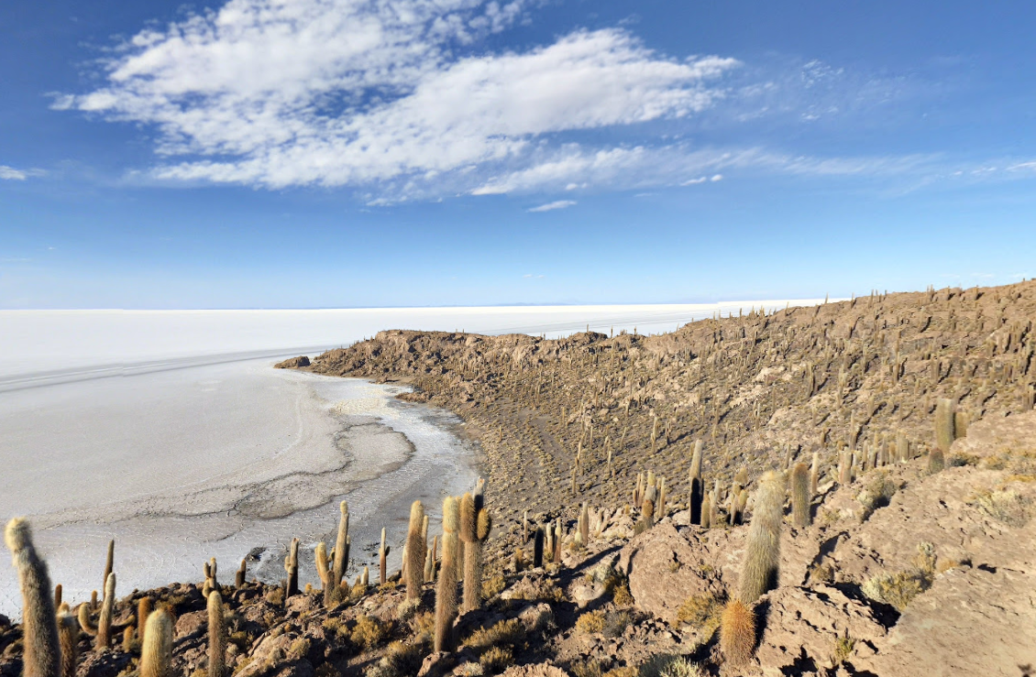
DESTINATION MANAGEMENT / MARKETING ORGANIZATIONS
PUBLIC SECTOR - WEAKNESSES: | PRIVATE SECTOR -WEAKNESSES:
Lack of interest in new bussiness & innovation, Weak in generating commercial income Reluctancy to take risks Tolerates bad results, Slow decision making, Lack of confidence in the private sector and profit motive | Lack of concern for the general public Limited interest for long-term planning Limited /inadequate resources Lack of confidence in the public sector/ conflictive interests

Slide 20
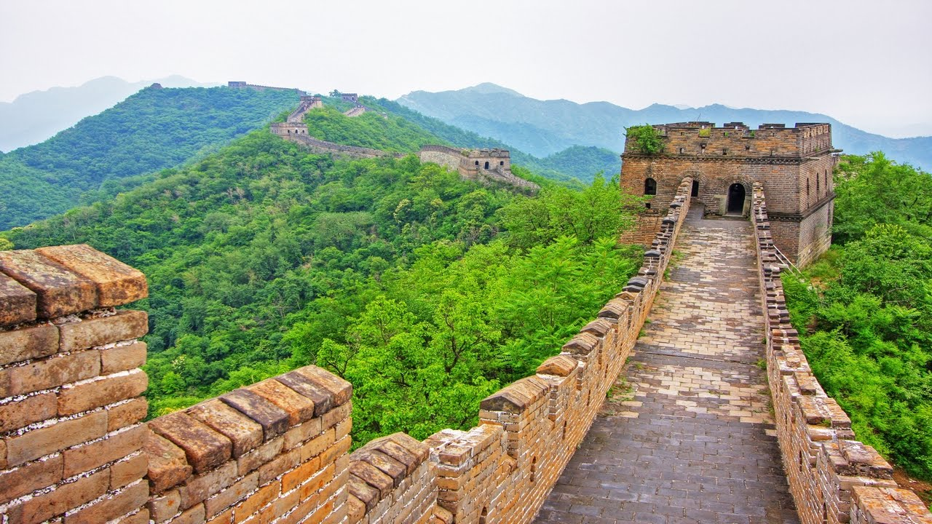
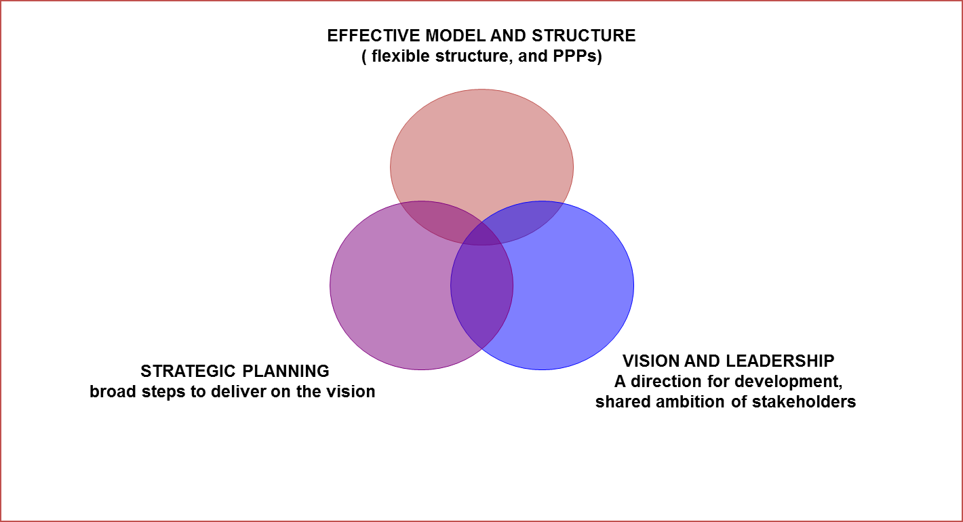
LINK BETWEEN THE SUCCESS OF A DESTINATION AND ITS DMO

Slide 21
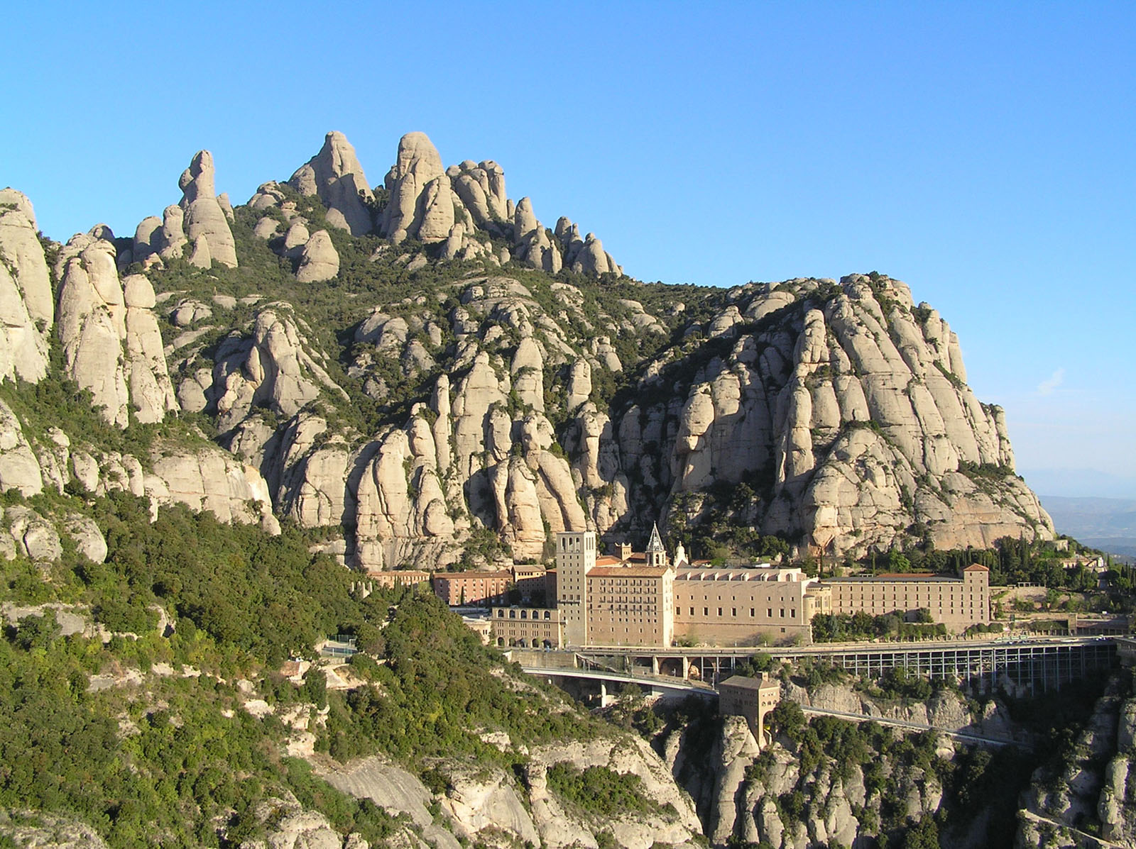
A FRAMEWORK FOR DEVELOPING A DESTINATION MANAGEMENT STRATEGY
(A STRATEGIC PLANNING MODEL)
SITUATION ASSESSMENT (where are we now?)
A STRATEGIC FRAMEWORK (where would we like to be?)
AN INTEGRATED, MULTI-YEAR IMPLEMENTATION PLAN (how do we get there?)
INSTITUTIONAL &PERFORMANCE MANAGEMENT ARRANGEMENTS – GOVERNANCE (what are the institutional arrangements for performance?)
1
2
3
4

Slide 22
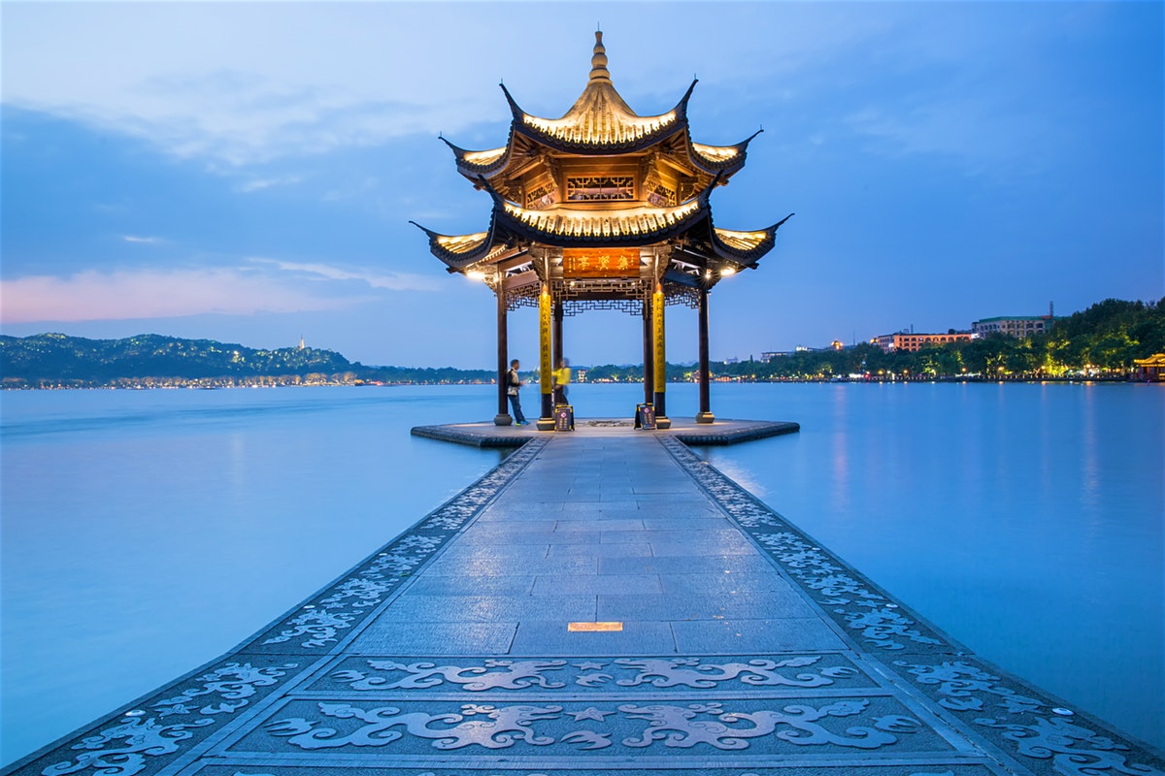
1. SITUATION ASSESSMENT
(WHERE ARE WE NOW?)
A macro environmental appraisal: political, economic, social and technological opportunities and threats,
A market analysis and assessment: market share and performance, market trends, customer profiles,
Tourism resources and services audit: attractions, services, routes and nodes,
An assessment of supportive infrastructure and services in the tourism value chain,
An analysis and assessment of the industry structure , current and future competitors, synergies with other destinations, local institutional collaboration.

Slide 23
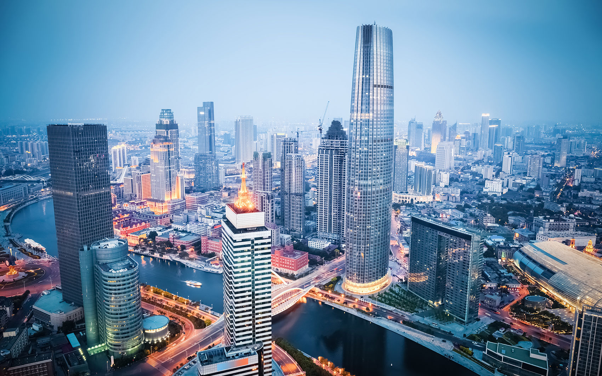
2. A STRATEGIC FRAMEWORK
(WHERE WOULD WE LIKE TO BE?)
A tourism vision : growth objectives and targets, core goals in pursuit of the vision,
Key strategies to achieve these goals,
A distinctive positioning and branding strategy to differentiate the destination from competitors,
A target market strategy to identify and profile the most appropriate and lucrative market segments, their profiles and preferences,
A suitable product portfolio to match target markets,
An assessment of critical success factors for destination positioning .

Slide 24
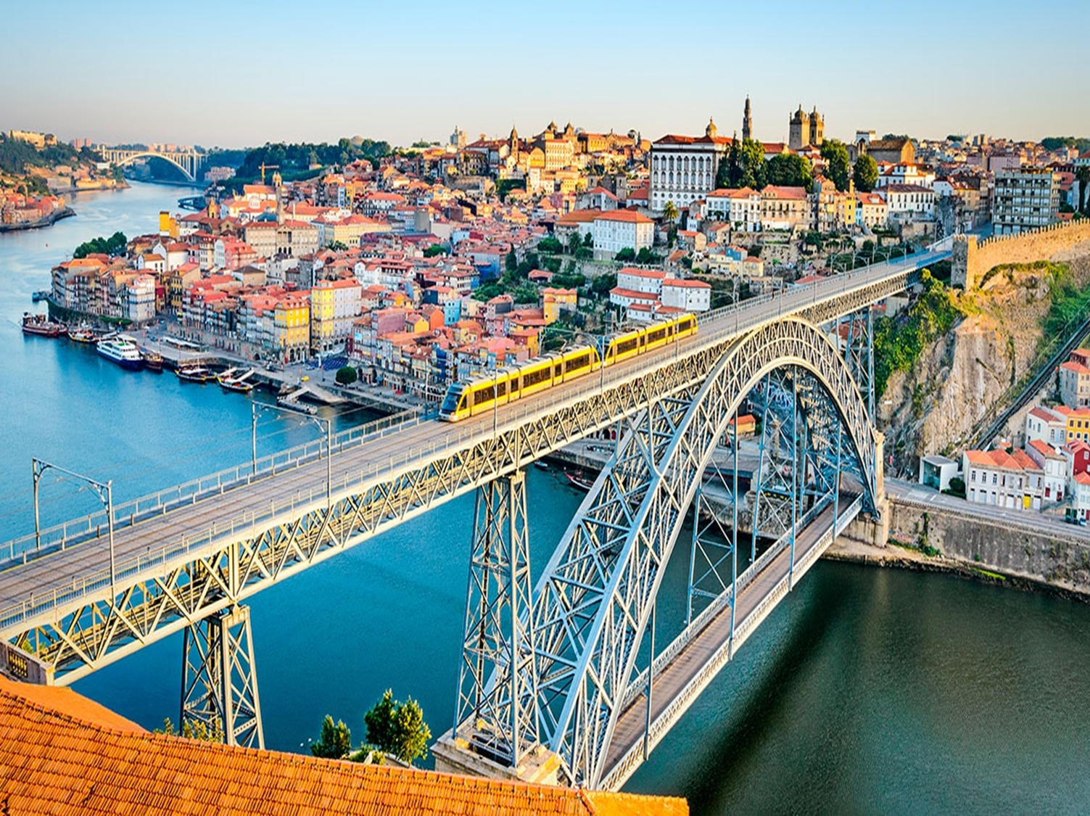
3. AN INTEGRATED, MULTI-YEAR IMPLEMENTATION PLAN
(HOW DO WE GET THERE?)
A tourism development programme and implementation plan:
  A sustainable growth policy,
  Land use plan : Zoning, spatial nodes and routes, regulations and standards;
  Critical infrastructure,
  Tourism information systems,
  New product development,
  Quality
  SME development, support infrastructure and services,
  Community involvement,
  Safety and security, etc.
  A tourism marketing programme and implementation plan:
  Must support the brand ,
  Must focus on target markets,
  Must use information technologies,
  Must include monitoring mechanisms,

Slide 25
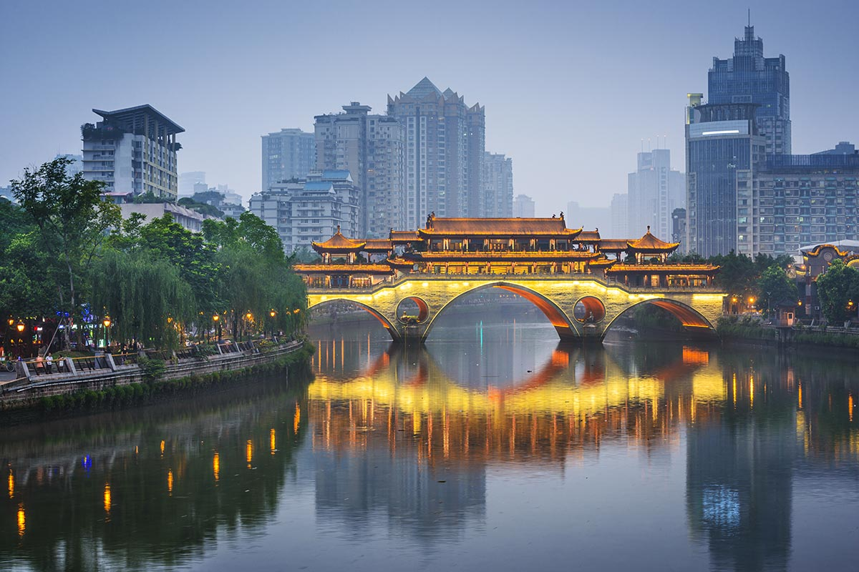
4. INSTITUTIONAL AND PERFORMANCE MANAGEMENT ARRANGEMENTS - GOVERNANCE
A Suitable Destination Management structure /model which:
Performs on the findings, the strategy and the implementation plan,
Complements other initiatives and structures ( e.g. national, regional policies and frameworks,
Is based on public – private partnerships,
Includes monitoring and evaluation mechanisms to measure and evaluate strategic performance.

Slide 26
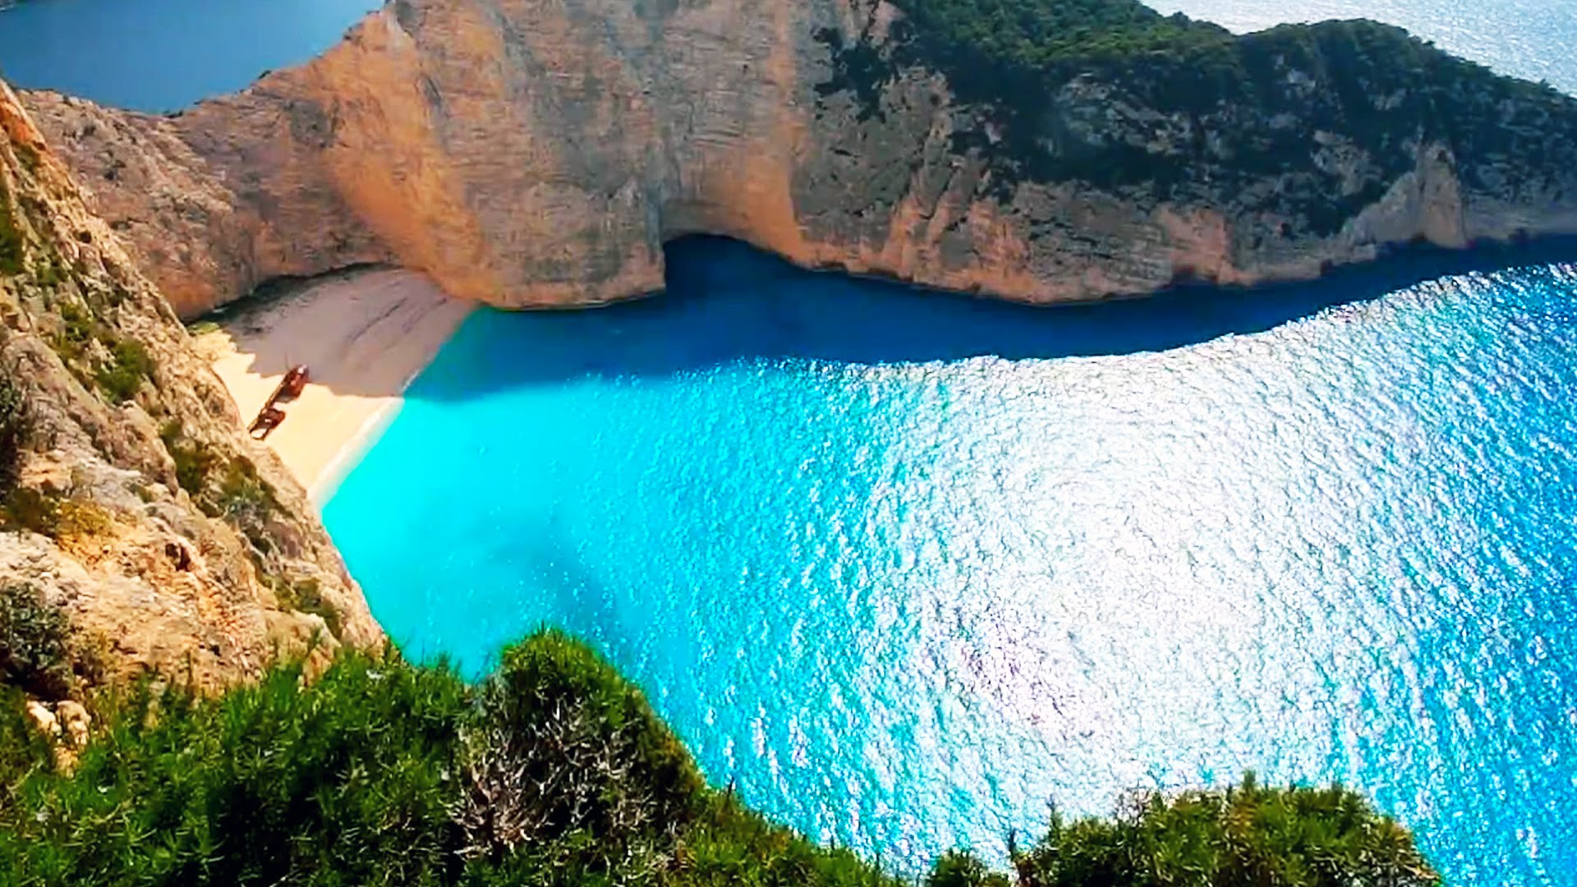
TOURISM PRODUCT DEVELOPMENT AND PRODUCT LIFECYCLE
Plan frameworks and strategies to develop new attractions, experiences, facilities and amenities by the public and the private sector; Improve the exisiting public attractions, facilities, amenities, Promote SMEs , Package and present the attractions, experiences, facilities and amenities. Encourage innovation. Manage the product life cycle ( extend the life cycle)
IDEA GENERATION:
Customers’ opinion, market research, competitors, destination stakeholders, intermediaries.
DEVELOPMENT:
Model or prototype development, test in marketing mix, revise plans
COMMERCIALIZATION:
Finalize the product and operate, implement marketing plan, conclude ROI
IDEA EVALUATION:
Concept testing, reaction from the customers, estimate of costs, revenues, profits
SCREENING:
Strengths and weaknesses, fit with goals, brand and target market needs, rough ROI
New Product Development

Slide 27

KEY PRINCIPLES IN TOURISM PRODUCT DEVELOPMENT (TPD)
TPD must be:
An integral part of overall tourism development strategic planning
Authentic and responsible ( natural and socio-cultural environment)
Differentiated from competitors,
Of a sufficient scale to make economic contribution to the destination,
In line with market trends, needs and interests, ( specific products for clearly identified segments)
Central, regional and local authorities must:
Identify and disseminate information about opportunities,
Plan and designate tourism development areas,
Facilitate incentives and support the private sector,

Slide 28
KEY PRINCIPLES IN TOURISM PRODUCT DEVELOPMENT (TPD)
Important steps:
Continuous consultation, coordination and collaboration with all the stakeholders, public, private and local community.
Long term vision, mid-term strategy and planning, short-term action plans,
Separate TPD zones depending on the strengths of each region,
Consider TPD as a set of experiences for the visitor based on themes or location,
Achieve the highest quality standards,
Achieve a blend of i) a major/flagship hub , ii) clusters and circuits of attractions and activities.

Slide 29
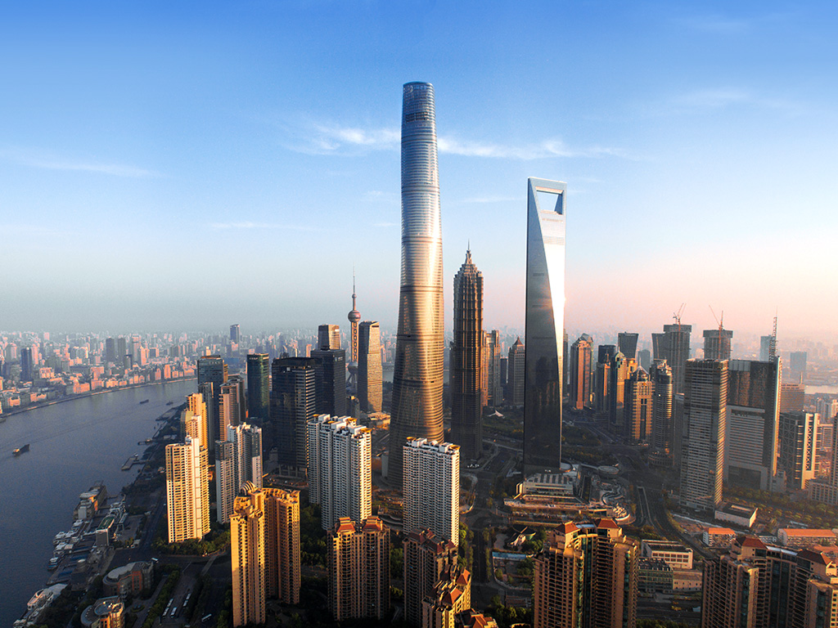
MARKETING FUNDEMENTALS AND KEY CONCEPTS
DESTINATION
VISION
IMAGE
BRAND
POSITIONING

Slide 30
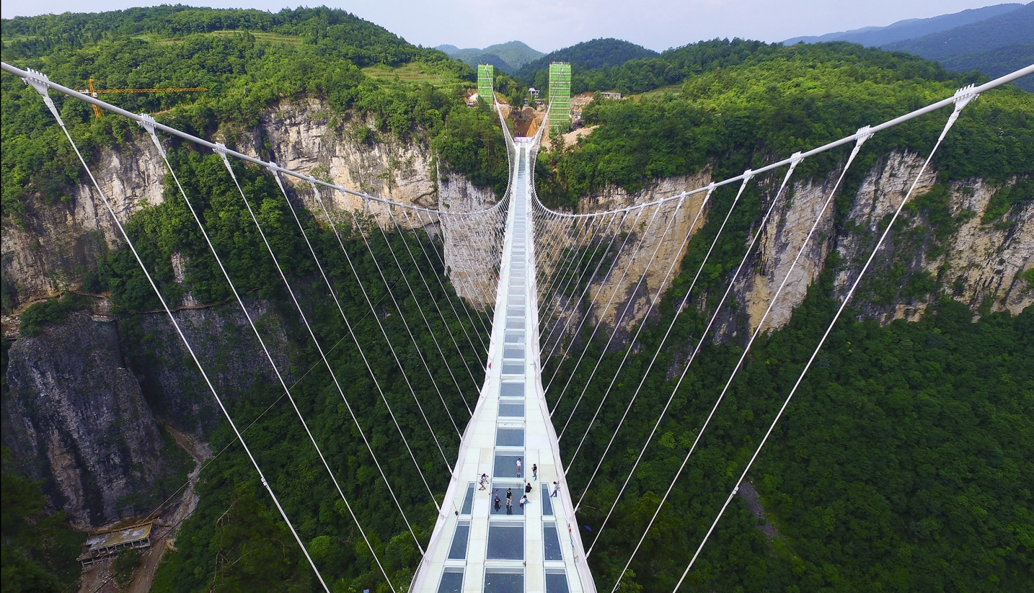
KEY CONCEPTS
DESTINATION VISION: is the created portrait and/or an overall picture of the desired future of the destination; it is an essential component of tourism policy and must integrate all the elements necessary for destination competitiveness;
DESTINATION IMAGE: is the total perception of an individual about a specific place based on visual and/or mental impressions, ideas, beliefs, feelings and knowledge. It is also derived from a broad spectrum of information sources as well as from the individual’s experience and it has an intricate relationship with historical, political, economic, social and cultural factors which may change over time and hence influence the image,

Slide 31
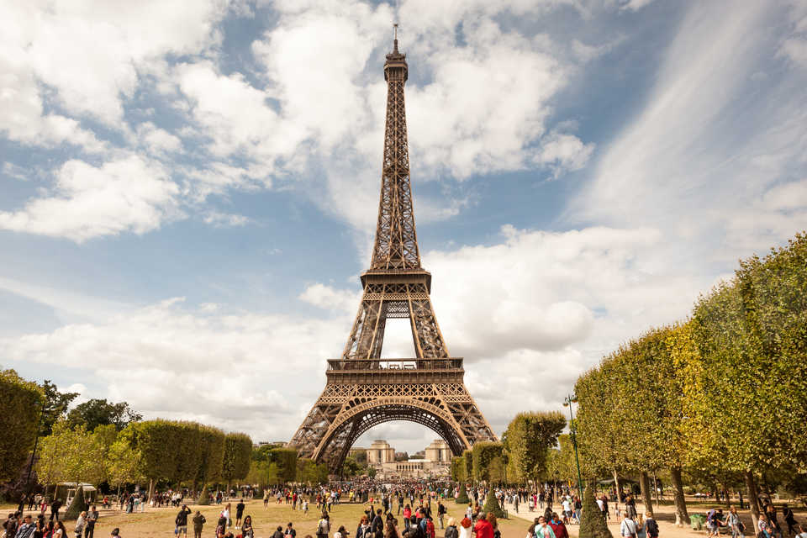
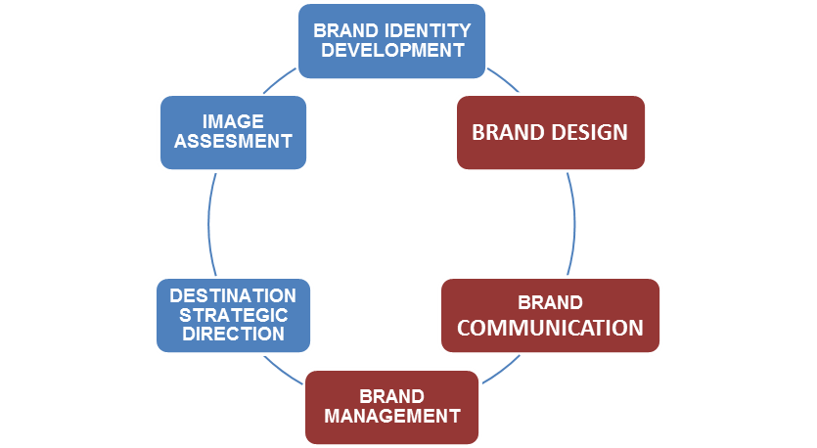
KEY CONCEPTS
DESTINATION BRAND: is a combination of tangible and intangible characteristics of a tourism destination which highlights the unique competitive identity and the distinctive personality of the destination and differentiates it from its competitors. The destination brand is not only a trademark (logo, symbol or icon) but an experience, image and a promise which signals a value system and positioning.

Slide 32


KEY CONCEPTS
DESTINATION POSITIONING is the perception of the destination in the marketplace by the actual and potential visitors in terms of the experience it provides relative to competing destinations.
DIFERENTIATION:

Slide 33
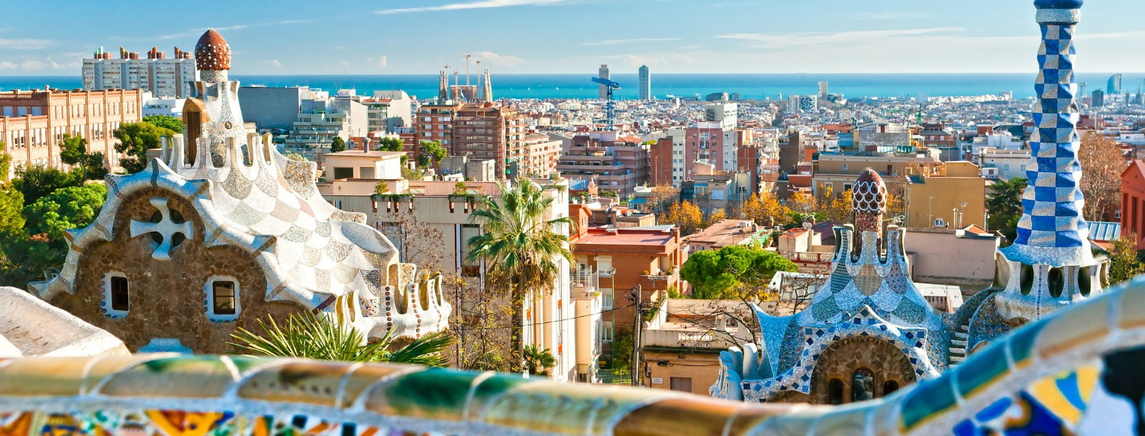
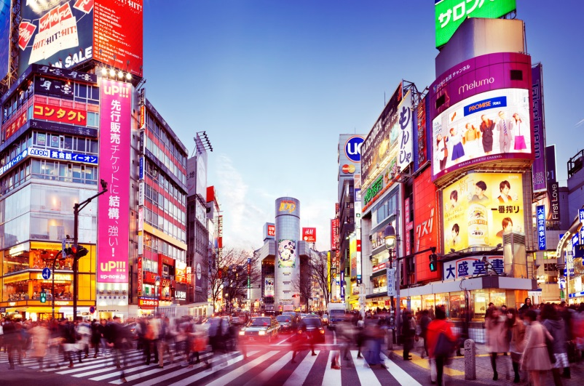
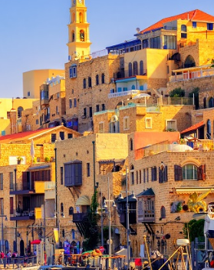
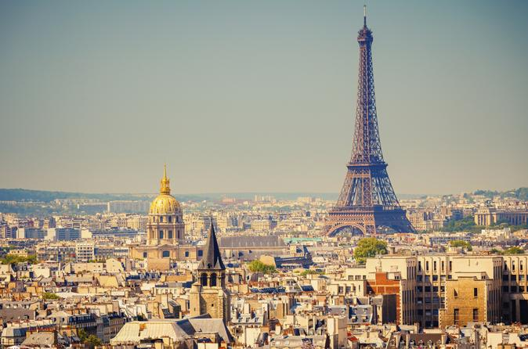
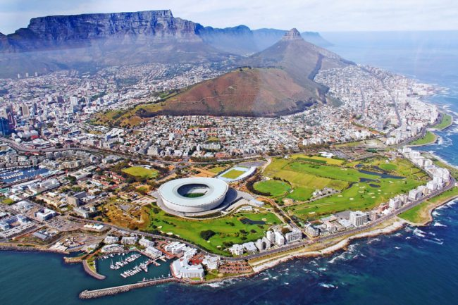
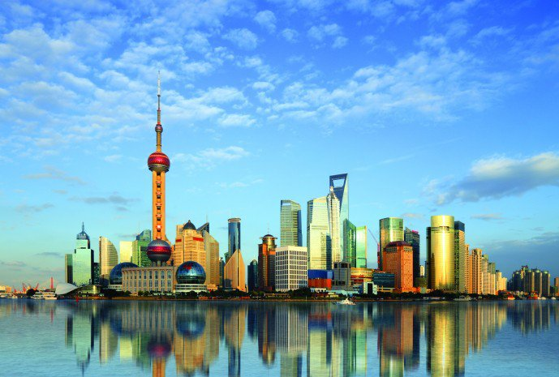
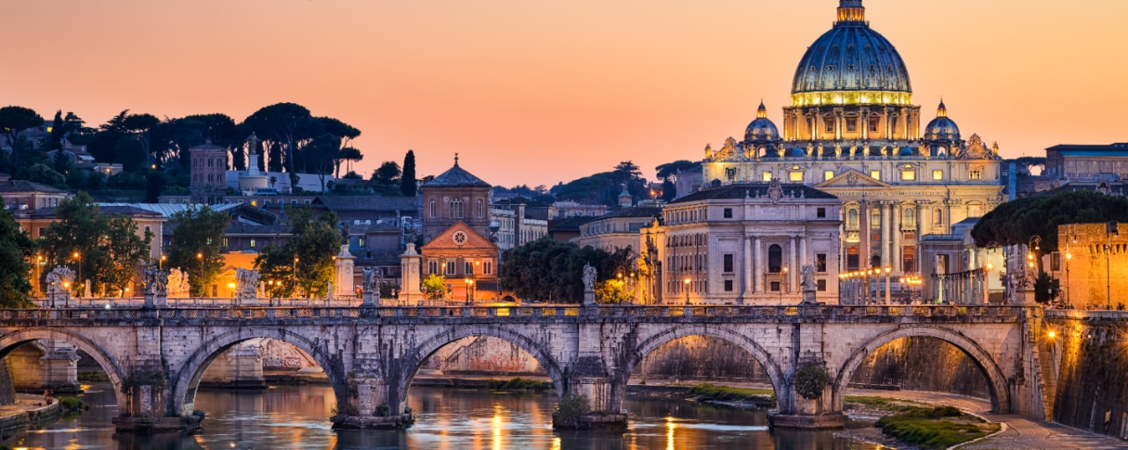
Differentiation

Slide 34
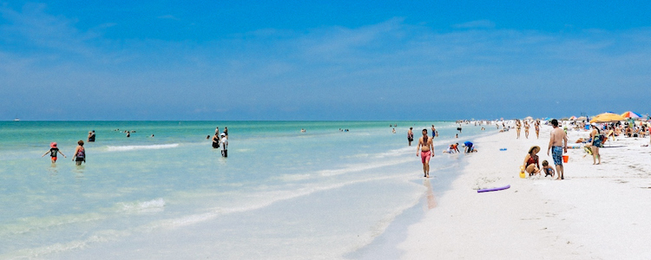
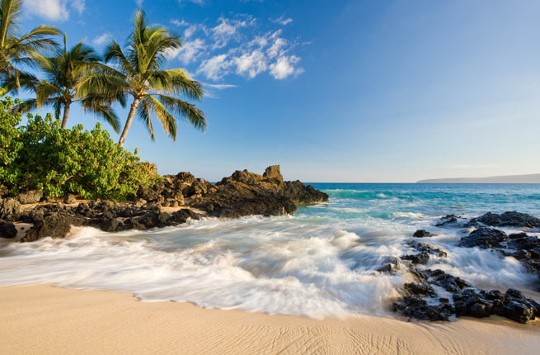
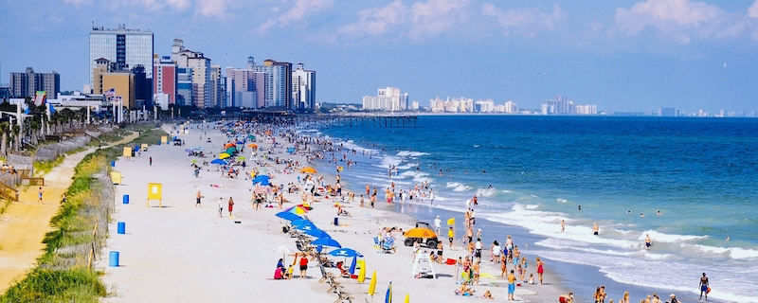
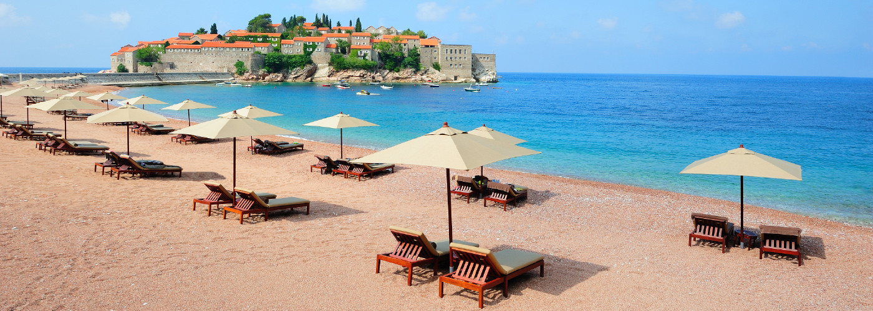
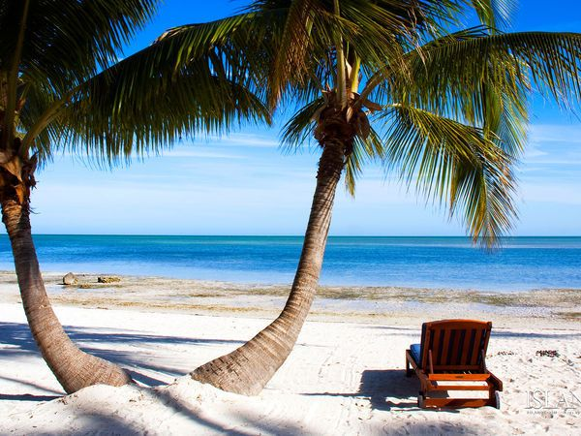
Differentiate or die…

Slide 35
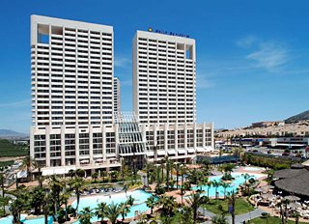
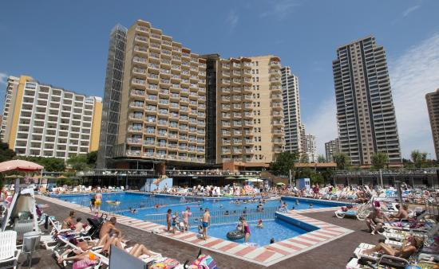
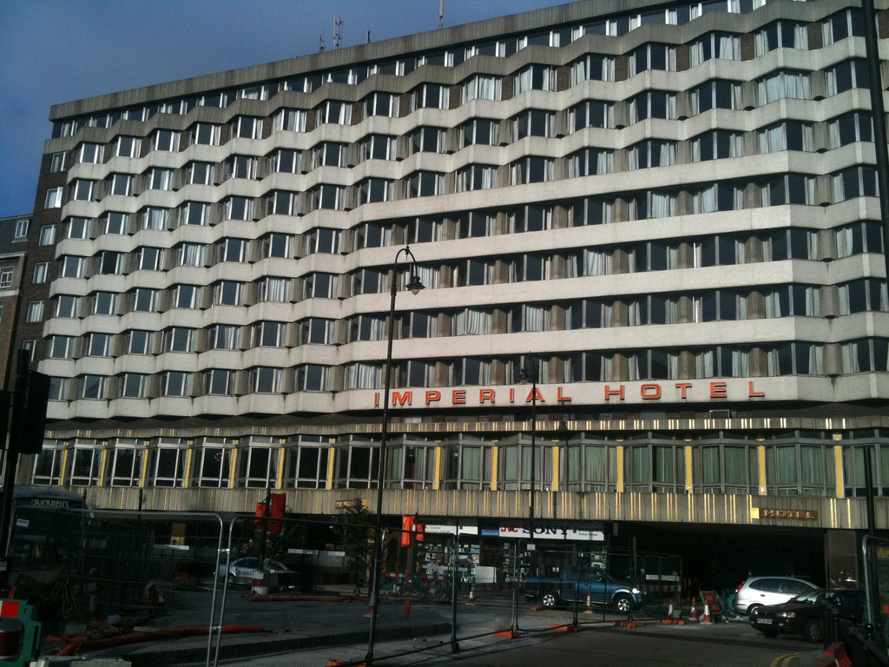
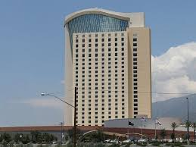
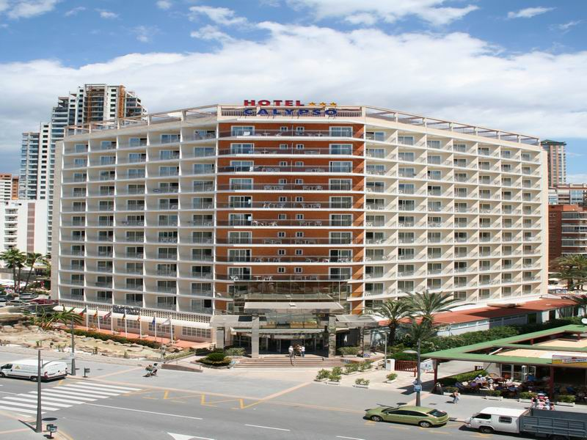
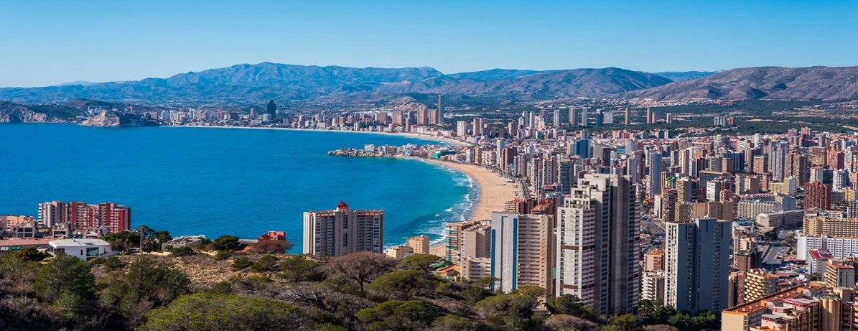
Differentiate or die…

Slide 36
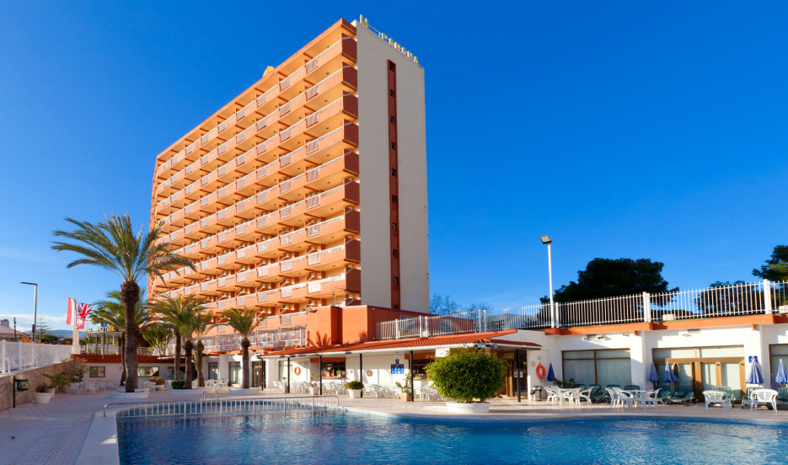
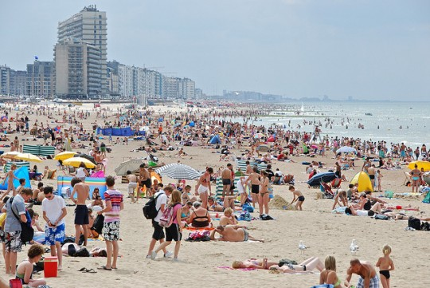
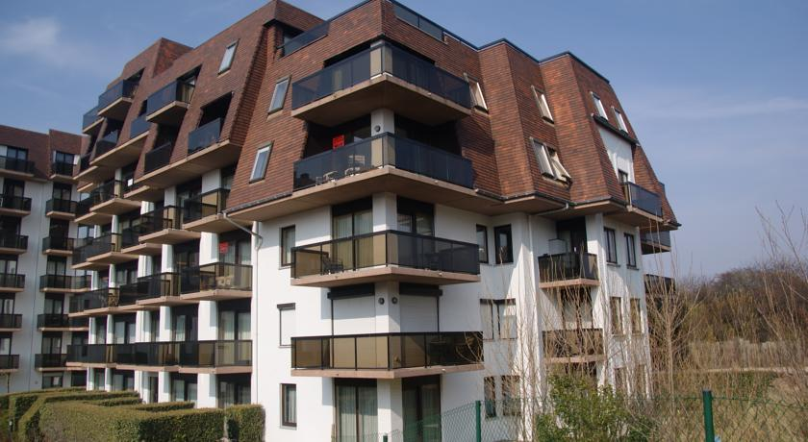
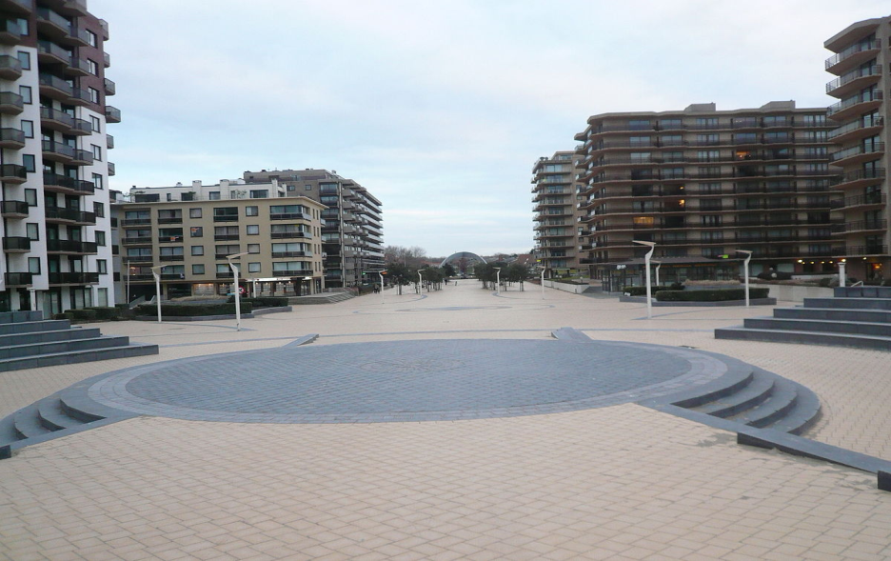
Generic

Slide 37
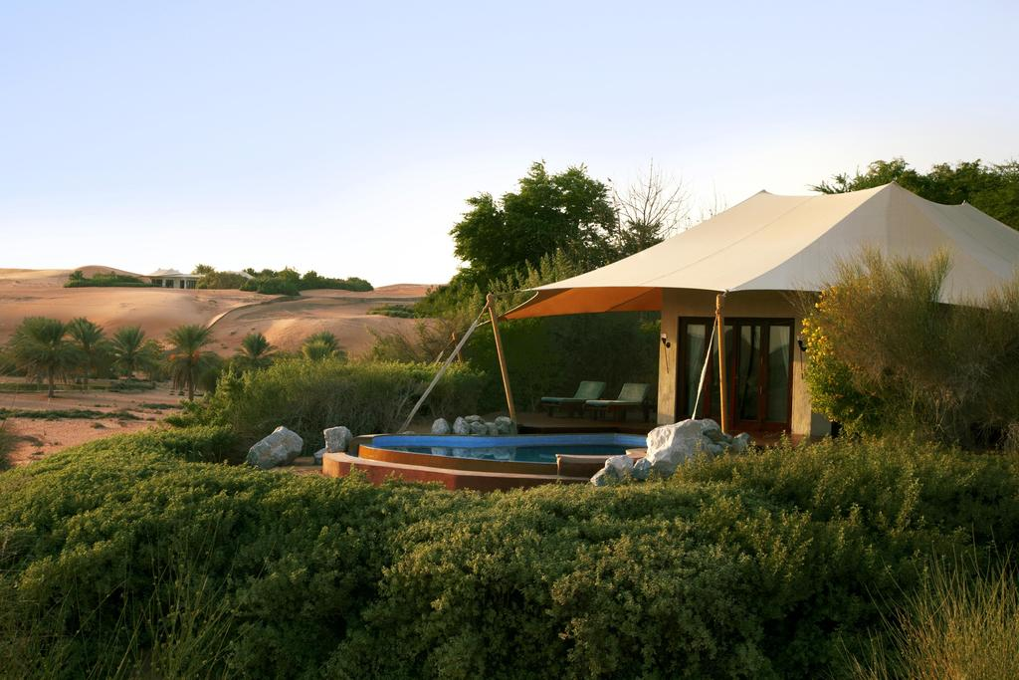
DISTINCTIVE:

Slide 38
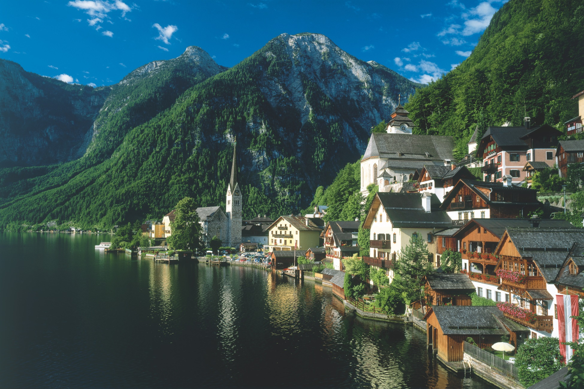

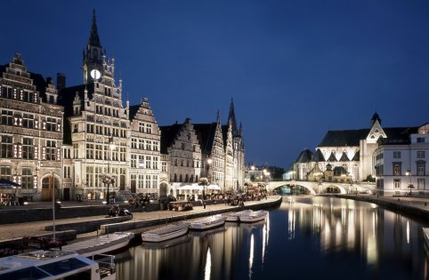



APPROPRIATE:

Slide 39





GASTRONOMY:

Slide 40







ARCHITECTURE:

Slide 41




CUSTOMS & TRADITIONS

Slide 42








LOCAL PRODUCTS:

Slide 43







And so much more; hospitality, lifestyle, etc.

Slide 44

MODEL FOR DESTINATION COMPETITIVENESS
DESTINATION COMPETITIVENESS:
The Competitiveness of a Tourism Destination is the ability of the destination to use its natural, cultural, human, man-made and capital resources efficiently to develop and deliver quality, innovative, ethical and attractive tourism products and services in order to achieve a sustainable growth within its overall vision and strategic goals, increase the added value of the tourism sector, improve and diversify its market components and optimize its attractiveness and benefits both for visitors and the local community in a sustainable perspective.

Slide 45


A SIMPLE DESTINATION COMPETITIVENESS MODEL
(Quantitative and qualitative factors for destination competitiveness)

Slide 46

QUALITY DESTINATION MANAGEMENT
Why?
Quality is vital for the success of a tourism destination and is considered as a decisive competitive instrument.
Quality in a tourism destination: is the result of a process which implies the satisfaction of all tourism product and service needs, requirements and expectations of the consumer at an acceptable price, in conformity with mutually accepted contractual conditions and the implicit underlying factors such as safety and security, hygiene, accessibility, communication, infrastructure and public amenities and services. It also involves aspects of ethics, transparency and respect towards the human, natural and cultural environment.
Quality, as one of the key drivers of tourism competitiveness, is also a professional tool for organizational, operational and perception purposes for tourism suppliers (UNWTO Definition).

Slide 47

QUALITY IN TOURISM
OPPORTUNITIES | CHALLENGES
PROFESSIONAL TOOL: Organizational (planning,awareness,committment ) Operational (continuous performance, monitoring) Perceptual (market recognition, commercial value) A MANAGEMENT MODEL: Public-private and inter-institutional committment. TOOL FOR MARKETING AND CREATING LOYALTY Customer needs and expectations PARAMETER FOR COMPETITIVENESS | Production and consumption are simultaneous actions Intangible ( abstract ) and symbolic components Heterogenous activity

Slide 48

QUALITY FOR WHOM (IN A DESTINATION) ?
CUSTOMER | INDUSTRY/SUPPLIER | LOCAL COMMUNITY | ENVIRONMENT
Visitor satisfaction, minimized uncertainity, maximized confidence Value for money | Competitive edge , differentiation factor Better products and services Customer loyalty Reducing costs, more profits Innovation Human resource improvement, stable industry | Well being of residents Percieved quality of life for the destination Improvement of infrastructure Public services and amenities Safety and security for local community | Conservation Enhacement Authenticity Aesthetics Rejuvenated local amenities

Slide 49

DESTINATION QUALITY AND THE CUSTOMER/
BASIC PRINCIPLES
Quality management must always focus on the CUSTOMER and CUSTOMER SATISFACTION.
Quality is a PARAMETER for competitiveness.
Quality must NOT be identified by “luxury”.
Quality of a destination is NOT the lump some of the individual quality products and services.
In each market segment, there is not any “perfect product” to satisfy all customers, real quality is built from the IMPLICIT NEEDS of the customer and not on his expectations or “wish list”.
Visitor satisfaction helps us measure “quality”, however, it does not reflect “objective quality” since it is associated with expectations and perceptions.
Quality performance is one of the key variables in determining the strengths and weaknesses of the destination.
Quality standards, awards and benchmarking are perishable and time sensitive and need regular monitoring.
Quality needs consensus with all the actors and stakeholders.

Slide 50

QUALITY ATTRIBUTES OF DESTINATIONS
SAFETY & SECURITY (PERCEPTION OF SECURITY)
NATURAL, CULTURAL AND MAN-MADE ENVIRONMENT
(including infrastructure)
HYGENE AND HEALTH CONDITIONS
( including waste management &water treatment, food safety, cleanliness, medical assistance)

Slide 51
QUALITY ATTRIBUTES OF DESTINATIONS
ACCESSIBILITY, COMMUNICATION AND SIGNPOSTING
(connectivity, transport capacity, accessibility FOR ALL to tourist attractions, frequency, scheduling, safety, signposting, etc.)
SOCIAL ENVIRONMENT AND LOCAL HOSPITALITY
(authenticity, respect for the visitor, other service suppliers, banks, cultural attractions, shops etc.
INTEGRATED QUALITY APPROACH
(accomodation facilities, food and baverage)

Slide 52

QUALITY ATTRIBUTES OF DESTINATIONS
LEGAL ENVIRONMENT AND CONSUMER PROTECTION
(regulation of tourism activities, professional skills of providers, price transparency)
POLITICAL ENVIRONMENT AND INSTITUTIONAL SUPPORT
(consistency with tourism development objectives, growth strategies, public services, human resources etc.)
COMPETITIVE ENVIRONMENT
(geographical location, climate, scale of the destination,

Slide 53

PROCESS FOR QUALITY MANAGEMENT
Assessment and diagnosis of destination quality : Auto assessment, auditing and visitor surveys.
Identification of quality objectives and policy: Setting the priorities through consensus of all partners and a quantifiable objective: eg. 3% improvement in a particular index; effective leadership.
Quality cost estimate:
Quality plan and implementación: continious improvement.
Quality assurance: standardization, certification and categorization.
Quality measurement and indicators: Quality attributes: e.g. Basic, neutral, questionable, contradictory, complementary and symbolic .
Monitoring and improvement.

Slide 54

STANDARDIZATION, CERTIFICATION AND CATEGORIZATION
STANDARDIZATION
Self regulated/ mandatory
CERTIFICATION
Generally voluntary
CATEGORIZATION
Mandatory
Defines technical specifications,
Generally a participatory process,
Market oriented,
Public service oriented
Recognition and validation
Market oriented,
Supported by norms
Independent, external validation
Commercial oriented
Associated with a brand
Administrative request
Supported by norms
Technical initiative
Ranking oriented
Supervised by the public sector

Slide 55

QUALITY IN TOURISM
ATTRIBUTES | INDICATORS
CONNECTIVITY Railways Ports & Airports Capacity Equipment for each segment | Travel time Connections Frequencies Distance to the centre Etc. Trafic congestion Occupancy (%) Congestion in use of facilities Supplementary services /1000 customer Available space for other services, Exchance bureaus Number of bank machines Language Etc.

Slide 56

BASIC QUALITY INDICATORS AT DESTINATION LEVEL
DESTINATION MANAGEMENT | MARKETING
Tourists and excursionists Length of stay Expenditure/visitor Number of days with exceeded carrying capacity Investments (by type)/ tourist Volume of employment generated by tourism Number of accidents, complaints Emergency response time Infringements Implementation of the tourism plan % Tourism land use % Green areas % Population density % Investment in maintanance of attractions/visitor/year | Total number of information queries Efficiency, visibility and timeliness in responding to requests Occupancy rate of information offices Total number of visits to the web site of the destination Percentage of repeat visitors in a specific period of time Percentage of customers who recommend the destination Percentage of companies with licence/certification Number of complaints Assesment of the quality/price survey Promotion budget/visitor Average cost of attracting new visitors Value of free promotion

Slide 57
BASIC QUALITY INDICATORS AT DESTINATION LEVEL
DESTINATION MANAGEMENT | MARKETING
SUSTAINABILITY ISSUES : Investment in public awareness campaigns Bussiness climate index Resident satisfaction index Local capital and the percentage of local bussinesses Energy consumption per person (resident+visitor)/day Contribution of tourism to the local economy ( % of GDP) by per capita income Concentration of CO2 / specific time period Physical environment ( customer survey) Revenue from tourism taxes Etc. | INTER-SECTORAL ISSUES: Customer survey for different sub-sectors Hygene and maintanance ( customer survey) Accessibility ( percentage of suitable equipment) Hospitality and behaivour ( customer survey) Health; number of health centres, beds, ambulances and pharmacies Security . Police and security staff and vehicles/1000 people Etc.

Slide 58

BASIC QUALITY INDICATORS AT DESTINATION LEVEL
(Destination Typology)
URBAN :
- Protection of cultural heritage ( %)
- Value of investment in conservation and restoration
- Street furniture ( quantity and quality)
- Parking space/1000 habitants
- Public transport
- Information centres
MOUNTAIN :
- Waiting time for the lifts and other mechanical equipment
- Waiting time for hiring equipment
- Parking capacity
- Information about ski slopes
- Bathrooms and toilets in the ski area
- Training courses
- Length of slopes
- Safety and security
RURAL :
- Km. of marked trails
- Accessible marked trails (km)
- Economic impact of tourism (revenues)
- Human resource management
COASTAL:
- Certified beaches (%)
- Chemical/biological analysis of sea water
- Beach equipment

Slide 59
















PROMOTING AND COMMUNICATING QUALITY
QUALITY BRANDS:
  Product brands: represents a single destination or a product :
  Prestige brands: represents top or near-top of the quality:
  Conformity seals:

Slide 60

POSITIONING TOURISM ON THE URBAN AGENDA
NEW PARADIGMS
Opportunities:
Volume of city tourism grew by more than 50 % between 2005 – 2015.
City tourism is growing:
  Urbanization rate is very high – Cities accommodate more than 50 % of the world population. By 2025, 600 cities will generate approximately 65 % of the world economic growth (UNHABITAT);
  Increased global mobility, information boom, accessible tourism products, knowledge sharing and digital platforms;
  Short break destinations with diversified attractions: culture, art, meetings, shopping, gastronomy, landscape, smart cities, etc.

Slide 61
POSITIONING TOURISM ON THE URBAN
AGENDA
Opportunities:
  Cities contribute to global tourism: 80 % of the tourists are generated from cities;
  Constitutes a central component in economy, social life and the geography of urban areas. It is an economic activity with a high potential to stimulate local economic growth because of its complementarity with other economic activities (GDP, job creation, foreign exchange and services exports);
  It creates spatial dynamics for transforming the urban landscape through the rejuvenation of public space, public infrastructure and connectivity, development of local amenities and recreational facilities thus improving the quality of life for the local community.

Slide 62

POSITIONING TOURISM ON THE URBAN AGENDA
Challenges:
  Greater competition of products and services with lower profit margins,
  City tourism will have better brands than destinations at national level. Promotional budget shifts from country to city levels;
  Immediate inconveniences: Environmental, social, cultural issues - pollution, congestion, overuse of public amenities, visitor-resident tension, crime, etc;
  Detrimental effects: “tourism can destroy tourism”, turistificación and erosion of quality visitor experience;
  Mature city destinations and emerging cities need different strategies, growth policies vs. lack of integration instruments;

Slide 63
POSITIONING TOURISM ON THE URBAN AGENDA
Challenges:
  Urban environment is the intersection and overlay of the natural environment, the built environment and the socio-economic environment. Cities have their own ecosystems;
  UNEP identifies: urban areas concentrate 80% of economic output, 60-80 % of energy consumption and approximately 75 % of CO2 emissions;
  HOWEVER: Tourism sector in general is responsible for about 5 % of global CO2 emissions and tourism contributes 4.6 % to global warming;
  The accommodation sector accounts for approx. 20 % of emissions from tourism. This includes heating, AC, maintenance of support services;
  Museums, theme parks, events, shopping etc. contribute by 3.5 %.
  Air transport has a share of 40 % of total carbon emissions.

Slide 64
POSITIONING TOURISM ON THE URBAN AGENDA
Challenges:
  New Platform Tourism services ( so-called sharing economy” is the new challenge: a real phenomenon and must be addressed and assessed by all the public and private tourism stakeholders within a comprehensive framework taking into consideration all its challenges and opportunities while promoting tourism as a driver of economic growth, inclusive development and environmental sustainability;
  Innovation must also be applied to the transformation of the city in terms of product, perception and brand;
  Collecting data “for the sake of data”;
  Visitor experience must be market driven, unique, authentic, personalized, environmentally and socially responsible :CREATE SENSE OF PLACE.

Slide 65

SUSTAINABLE TOURISM FOR URBAN DEVELOPMENT:
A FRAMEWORK OF KEY ISSUES
1. Sustainable economic growth:
Tourism in Cities:
Helps to create the right environment for resilient and sustainable economic growth;
Creates spatial dynamics for transformation, rejuvenation, regeneration, infrastructure, connectivity;
Stimulates innovation – Information technology and new business models. Benefits for the visitors and the local community
Consolidates the international reputation of the city and contributes to economic positioning and competitiveness at global level;
Urban development policies and urban land use plans must give full consideration to the needs of a sustainable tourism development, including the spatial distribution of tourist attractions, promotion of accessibility and conservation of natural and cultural heritage.

Slide 66
SUSTAINABLE TOURISM FOR URBAN DEVELOPMENT:
A FRAMEWORK OF KEY ISSUES
2. Social Inclusiveness, Employment and Poverty Reduction
Tourism in Cities:
Ensures creating skilled labour and decent jobs, reduces poverty and provides equatible opportunities to the majority of the demographic segments;
As a labour focused industry, provides valuable non-economic mutual benefits to the employee and the visitor;
Plays a potential role in enabeling the low income groups to get engaged in the supply of goods and services to tourism operators hence formalizes economic activities in the shadow economy;
Encourages SME s,
Enhances skills, knowledge and capacity building, allows integration of skilled labour to other sectors of the economy

Slide 67
SUSTAINABLE TOURISM FOR URBAN DEVELOPMENT:
A FRAMEWORK OF KEY ISSUES
3. Urban Culture and Heritage
Tourism in cities:
Enhances the synergy between tourism and culture, mutual benefits;
Is a catalyst for revenue regeneration for the innovative practices in heritage conservation;
Culture is recognized as key source and asset for sustainable urban development.

Slide 68

CHANGE AND INNOVATION:
The Digital Revolution and the Millennial Traveler
It is increasingly important to clearly understand the power of IT and the digital media, its impact on the society, the fast changing dynamics and their relevant use in tourism,
Cities need to re-address themselves and be pro-active with the business and the customer and be flexible with information and the rapidly changing media applications,
Private tourism services offered through digital platforms ( so called sharing economy) is the new challenge and captures the fastest growing customer segment,
Along with some possible opportunities, the challenges ( governance issues, re- competition, labour conditions, consumer protection etc. needs to be well addressed and managed by engaging all the related stakeholders.

Slide 69

CHANGE AND INNOVATION:
The Digital Revolution and the Millennial Traveler
Digital traveler has a different behavior and consumption patterns. Looks for experience and story telling likes sustainable products, last minute decision maker, likes sharing ( customer for the new digital platforms), well connected , well educated.
The millennials form a huge market they dictate the future of travel and tourism industry.
“Youth” needs to be embraced by the destinations and tourism businesses. It is no longer a niche market ; it is a huge market segment which generates 286 billion US Dollars.
Stay is longer, high spenders, innovative, a resilient segment, get cultural benefits, flexible, return to the destination.

Slide 70

CHANGE AND INNOVATION:
The Digital Revolution and the Millennial Traveler
“Youth” looks for festivals, culture , museums, shopping, free wi -fi,
Look for content in social media, interactive communication, fast access,
Millennials are frequent travelers and combine business trips with leisure,
Accommodation industry is also adapting to the mindset, needs and expectations of this segment. Innovative approach is useful. Also WI FI is a MUST.
The City Destination Management Organizations have the leadership role in launching reliable research and market intelligence so as to adapt to new customer paradigms, address the challenges and advocate transparent norms and regulations for the customer and the industry.

Slide 71

2. BEIJING (CHINA)
STRENGHTS:
Rich cultural heritage - well protected Steady growth in demand and revenue (domestic and international markets) Connectivity (new airport 2019) Urban public transport Diversified accomodation Culinary experience (diverse gastronomy as an attraction) Government and management structure under Municipal Government and Tourism Commission- multi agency effort Strategic planning (5 year development plan, policy measures and action plans- tourism is a priority) Introduction of sustainable tourism initiatives in the plan | The structure allows for an integrated approach for tourism development and vertical and horizontal coordination with the stakeholders at city level (resource deployment, zoning, business development, promotion &marketing, legislation and regulations, quality management , safety and security, training (2016-2020) institutional reform- DMO to be put in place Strong and systematic government support (land allocation, taxation, finance, infrastructure, public services, SME support, incentives for innovation,

Slide 72

KEYS FOR SUCCESS
Vision and leadership for a sustainable and competitive tourism,
Knowledge and understanding of the needs of our target markets and the “new tourist”,
Connectivity and infrastructure,
Ensuring destination quality performance,
Legal framework and incentives for sustainable growth,
Positioning and differentiating our destination and “image management”,
Improvement of collecting reliable data and competent analysis of the data,
Improvement of the competitiveness of the destination, providing “through the chain”, positive visitor experience,
Product innovation and management,
Capitalizing on the opportunities provided by new technologies,
Greater professionalism in service levels and overall HR management,
Synergy between all the stakeholders in creating the destination vision,
Public-private sector partnership in the key areas of management and marketing,
Continuously adapting to the dynamically changing macro, competitive and market environments.

Slide 73


CITIES MUST BE LIVEABLE, LOVABLE AND PROFITABLE
THINK GLOBALLY, ACT LOCALLY AND
COMPETE WITH ATTITUDE
谢谢
Esencan Terzibasoglu
Director
Destination Management & Quality
eterzibasoglu@unwto.org

